Slide 1
AICW ENGINEERING SPOKE | PROJECT PRESENTATION 2026
AI-Powered Travel Destination Recommender
Using Deep Learning
Matching every traveler to the best Indian destination with a trained neural network.
M. Jayasree, jmogusani@gmail.com
Akkem Kavya, 238r1a12k4@gmail.com
Muppidi Anusha, laxmanmuppidi9704@gmail.com
Guided by
Narasimhula L V Venu Gopal

Slide 2
Outline
1
Abstract of the Project
6
Results (Model Evaluation)
2
Problem Statement
7
Video of Project Demonstration
3
Proposed Solution
8
Conclusion
4
System Architecture
9
Future Scope
5
Live Demo / Output Screenshots
AI-Powered Travel Destination Recommender
2

Slide 3
Abstract
Planning a trip across India means weighing budget, season, travel group and personal interests all at once — something generic travel sites rarely do well. This project builds an AI-powered travel recommender that uses a trained deep learning model (TensorFlow / Keras) to match a traveler's preferences to the single best destination out of 15 curated locations across India.
The model is a Multi-Layer Perceptron trained on 4,500 traveler records, taking 6 inputs — Budget, Duration, Season, Travel Group, Core Preference and Region — and returning the top destination with an AI confidence score and 3 close alternatives. A Flask web app wraps the model with login, an interactive preference form, and a rich results page with live photos and a complete travel guide.
AI-Powered Travel Destination Recommender
3

Slide 4
Problem Statement
Choosing a destination among India’s many options is overwhelming for most travelers.
Generic travel sites recommend the same popular spots to every visitor.
Rule-based, if-else logic can’t capture how budget, season, group and interests combine.
Travelers get little guidance on the best time to visit or weather suitability.
Manually researching destinations, weather and attractions takes hours.
15+
curated destinations,
endless traveler needs
AI-Powered Travel Destination Recommender
4

Slide 5
Proposed Solution
Use a trained deep learning model to automatically match traveler preferences to the best destination, with a measurable confidence score.
1
2
3
4
Trained Neural Network
Personalized Matching
Confidence Scoring
Interactive Web App
A Multi-Layer Perceptron (128-64-32 neurons) trained on 4,500 traveler records.
Learns from 6 real inputs: Budget, Duration, Season, Group, Preference, Region.
Softmax output gives a top match plus an AI confidence % and 3 alternatives.
Flask app with login, live photos, a full travel guide, and a REST API.
AI-Powered Travel Destination Recommender
5

Slide 6
System Architecture
User Input
(6 Preferences)
Preprocessing
(OneHot + Scaler)
Neural Network
(128–64–32 Dense)
Softmax Output
(15 Destinations)
Recommendation
+ Confidence %
A traveler's 6 preferences are encoded into a 25-dimensional feature vector, passed through a trained neural network, and scored by a Softmax layer across 15 destinations — returning the top match with a confidence percentage.
AI-Powered Travel Destination Recommender
6

Slide 7
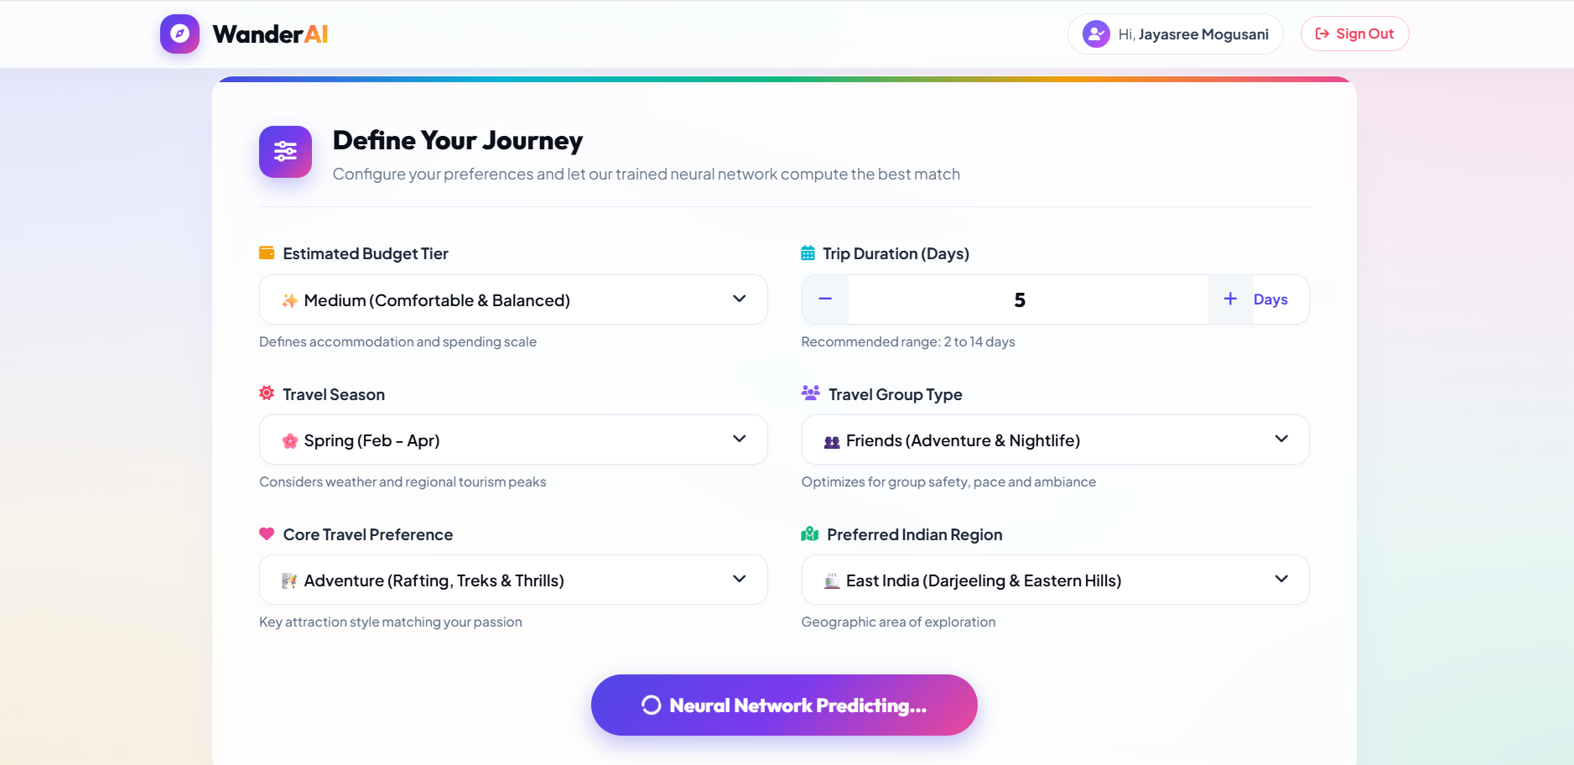
Live Demo — Output Screenshot
AI-Powered Travel Destination Recommender
7

Slide 8
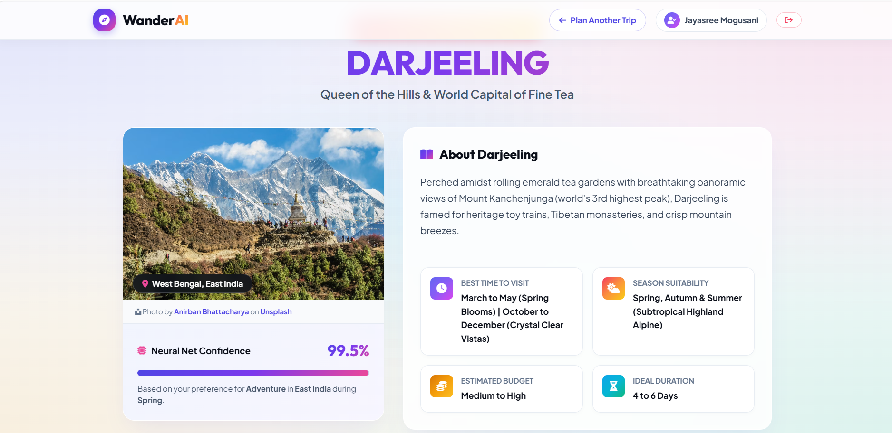
AI-Powered Travel Destination Recommender

Slide 9
Results — Model Evaluation
Split | Accuracy | Loss
Training | 94.35% | 0.1143
Validation | 94.07% | 0.1119
Test (unseen) | 93.78% | 0.1180
93.78%
Test Accuracy
0.94
Macro F1-Score
Evaluated across all 15 destination classes on 4,500 traveler records (train / validation / test split).
<25ms
Inference Speed
AI-Powered Travel Destination Recommender
8

Slide 10
Video of Project Demonstration
Demo walkthrough: Login → Fill preference form → Predict → View destination, confidence & travel guide
Watch the demo: https://github.com/Jayasree-2503/AI-powdered-Travel-Destination-Recommendation-Using-Deep-Learning/raw/main/AI_Travel_Destination_Demo_Small.mp4
AI-Powered Travel Destination Recommender
9

Slide 11
Conclusion
A trained deep learning model can reliably match travelers to the right Indian destination.
The neural network reached 93.78% test accuracy with a macro F1-score of 0.94 across 15 destinations.
Inference runs in under 25 ms, fast enough for a real, interactive web app.
A working Flask app with login, live photos and a full travel guide shows a complete, usable end-to-end system.
AI-Powered Travel Destination Recommender
10

Slide 12
Future Scope
1
Expand beyond India to cover international destinations.
2
Add multi-city itinerary planning across a full trip.
3
Pull in real-time weather and pricing data for each destination.
4
Collect user feedback to retrain and keep improving the model.
5
Deploy the Flask app to the cloud for public access.
AI-Powered Travel Destination Recommender
11

Slide 13
Thank You
AI-Powered Travel Destination Recommender | AICW Engineering Spoke
github.com/Jayasree-2503/AI-powdered-Travel-Destination-Recommendation-Using-Deep-Learning

